Slide 1

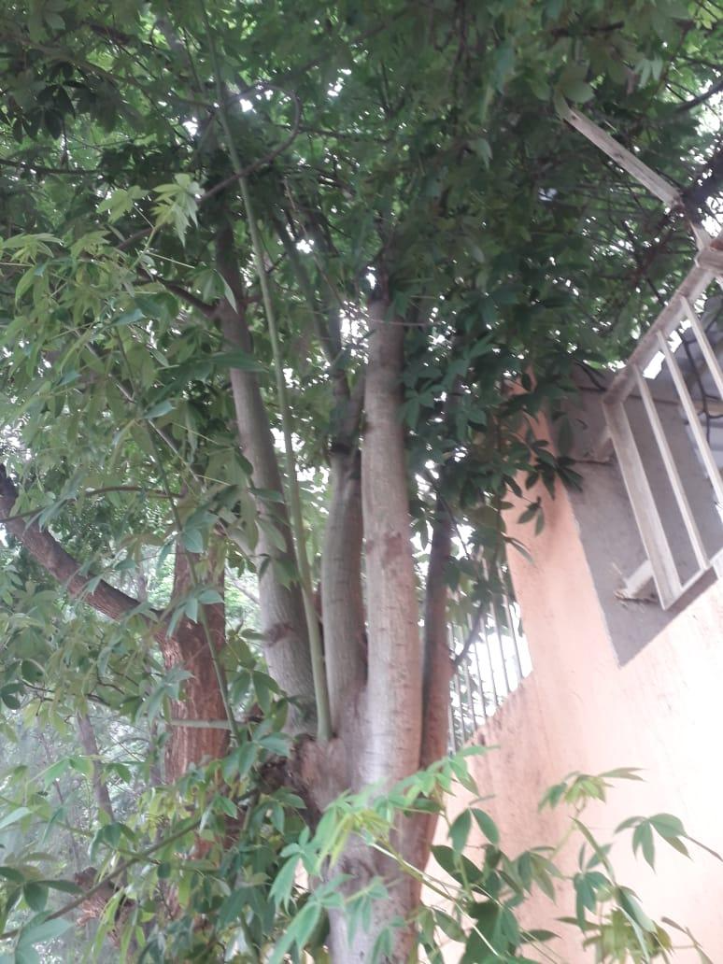
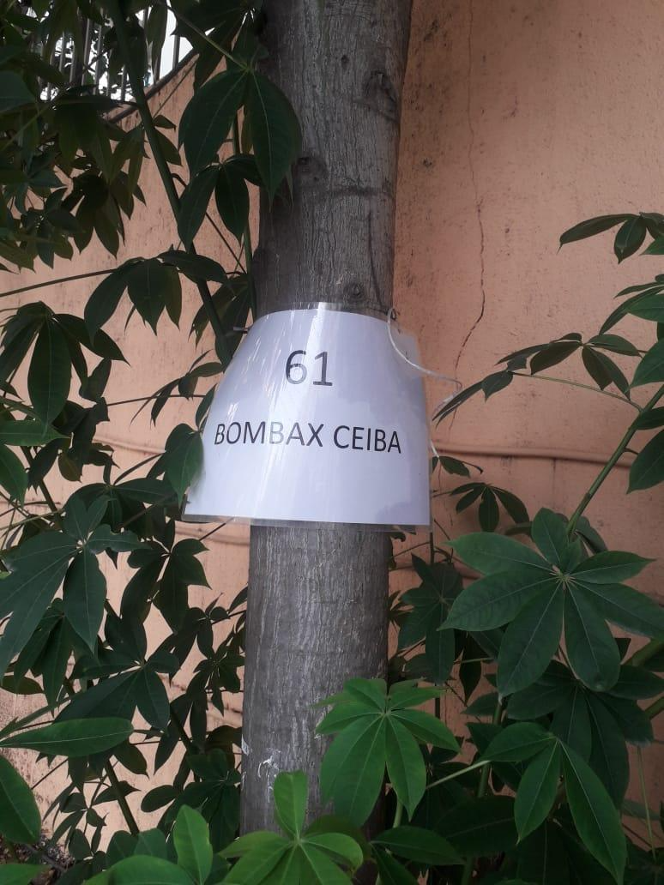
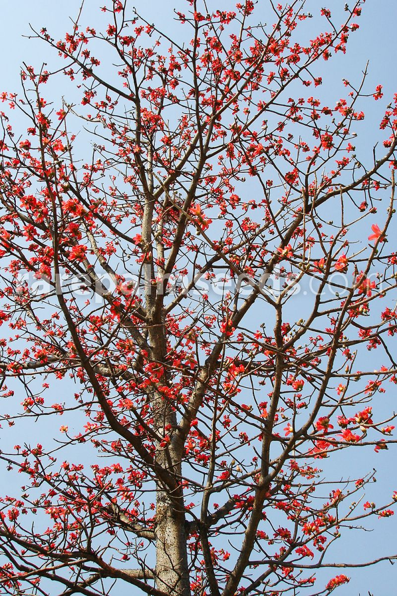
BOMBAX CEIBA
Near Turf court AIS Campus, Wakad.

Slide 2
Common Name : Semal
Scientific Name : Bombax Ceiba
Family : Bombaceae.
Habit : Bombax ceiba, is a large, spiny, deciduous tree
is native to monsoon forested areas including river valleys,
savannas and hillsides in areas where soil moisture levels often change
significantly during the course of a year.
Distribution : It is found in Brazil, Cuba, Dominican Republic, Guyana, Haiti, Trinidad
and Tobago, India, Myanmar, Thailand, Pakistan, Papua New Guinea,
Nepal, Sri Lanka, China, Indonesia and Taiwan.

Slide 3
Description :
Height of Tree : About 20-60 m (65-196 ft).
Leaves : The leaves are palmate with 6 leaflets radiating from center point with an average size of 7-10
centimeters (2.5-4 in) wide and 13-15 centimeters (5-6 in) long.
Flower: Cup shaped flowers present, an average of 7–11 centimeters (2.5–4.5 in) wide, 14
centimetres (5 in) in width, petals up to 12 centimeters (4 in) in length.
The tree starts dropping its leaves each year in January-February in anticipation of flowering
(March-May)
Fruits: The fruit, which reaches an average of 13 centimetres (5 in) in length, is light-green in color in
immature fruits, brown in mature fruits. Flowering season is from March onwards
Bark of the tree : Bark is grey in colour.
Seeds : Seeds are numerous, long, ovoid, black or gray in colour and packed in white cotton.

Slide 4
Fruits: Good source of silk-cotton for making mattresses, cushions, and pillows. They are used in the treatment of cholera, tubercular fistula, coughs, urinary complaints, nocturnal pollution, abdominal pain due to dysentery, and impotency.
Leaves: The leaves are hypotensive and hypoglycemic. They are combined with Vitis spp, to treat carbuncle; and with Terminalia alata to treat hematuria. The knots or the stem are used on bleeding gums (cooked in mustard oil with the bark of Ziziphus rugosa and Ichnocarpus frutescens and then eaten.
Bark: The bark is reputedly used against cholera (usually combined with many other plants), pleurisy, and stings and as a diuretic. It is used in bandages for lasting fractures or given in infusion for toothache before visiting the dentist. It is reported to contain important phytoconstituents such as naphthol, naphthoquinones, polysaccharides, anthocyanins, shamimin and lupeol.
Gum: The gum is astringent, demulcent and tonic.

